Slide 1

Automatic Grading of Online Formative Assessments using Bidirectional Neural Networks and Attention Mechanism
Xavier Lien and Advay Pakhale
Notes:
Hello everyone, I am Xavier and along with Advay, we will be sharing our experiences doing a science research project under the raffles science institute and science research programme (CLICK)

Slide 2
Research Aim
Motivation for our project
Notes:
So now we will be talking more about what our project was about, starting with our research aim

Slide 3
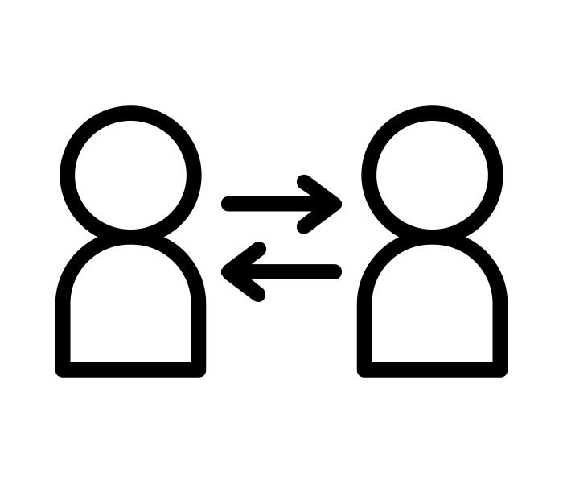

Research Aim
Online formative assessments (FAs)
Provide Feedback
Highly Beneficial
Notes:
Our project focused on online formative assessments, which are basically any assignments like homework or small quizzes done on platforms like ivy. They place a primary focus on providing qualitative feedback for both teachers and students. This is in contrast to summative assessments, like your graded tests, where the main focus is only on providing a quantitative score (CLICK) Formative assessments have been shown to be highly beneficial in the learning process as compared to summative assessments

Slide 4




Research Aim
Automate the Task?
Timely Report of Progress
Time Consuming
and Tedious
Notes:
However, giving personal feedback to each student is time-consuming and tedious for teachers. (CLICK) If we could automate the grading process, (CLICK) open-ended formative assessments could be administered more easily and frequently, benefiting both students and teachers through timely report of progress. (CLICK)

Slide 5
Literature Review
And an overview of our proposed solution
Notes:
The next step of any project is to look at what other people have worked on so that we can know what areas to explore(CLICK)

Slide 6
Literature Review
Focus mainly on grading summative assessments
Primary focus is on generating a score, not feedback
Need for new architecture to fulfil aims of grading FAs
Notes:
And as it turns out, much of the literature on automatic grading focuses mainly on grading summative assessments. The problem is that (CLICK) the primary focus of research we found is producing a quantitative score. However, what one requires from formative assessments is qualitative feedback, which has not been explored widely at all.
(CLICK) Therefore, there is a need for a new architecture to fulfil the aims of grading formative assessments. (CLICK)

Slide 7
Proposed Solution: Automatic Grading
Notes:
Our proposed architecture leverages on two aspects (CLICK)

Slide 8
Proposed Solution: Automatic Grading
Notes:
- Student answers and a teachers’ marking scheme which are essentially just marking points for point-marked short answer questions. (CLICK)

Slide 9
Proposed Solution: Automatic Grading
Notes:
The student answers serve as input to the quantitative component of our architecture, (CLICK)

Slide 10
Proposed Solution: Automatic Grading
Notes:
which produces a quantitative score. (CLICK)

Slide 11
Proposed Solution: Automatic Grading
Notes:
Now both the student answers and the marking points are used as input to the qualitative component of our architecture, (CLICK)

Slide 12
Proposed Solution: Automatic Grading
Notes:
which produces qualitative feedback.

Slide 13
Methodology
Collection and pre-processing of datasets, quantitative and qualitative components
Notes:
So now we will talk about how we implemented our proposed solution (CLICK)

Slide 14
Datasets and Pre-processing
Notes:
Let’s first take a look at how we got our datasets and pre-processed them. First, a thermodynamics online quiz was conducted on 292 secondary 2 raffles institution students (CLICK)

Slide 15
Datasets and Pre-processing
Notes:
Next, we spilt the answers collected into 2 datasets, based on the 2 questions.
The first question is a simple recall question, while the second one is a more complex application-based question (CLICK)

Slide 16
Datasets and Pre-processing
Notes:
The 2 datasets are then marked by the entire level of 3 physics teachers. This is using a simple marking scheme comprising multiple marking points (CLICK)

Slide 17
Datasets and Pre-processing
Notes:
The answers are then pre-processed to make all the letters lowercase, remove punctuation and remove stopwords (CLICK)

Slide 18
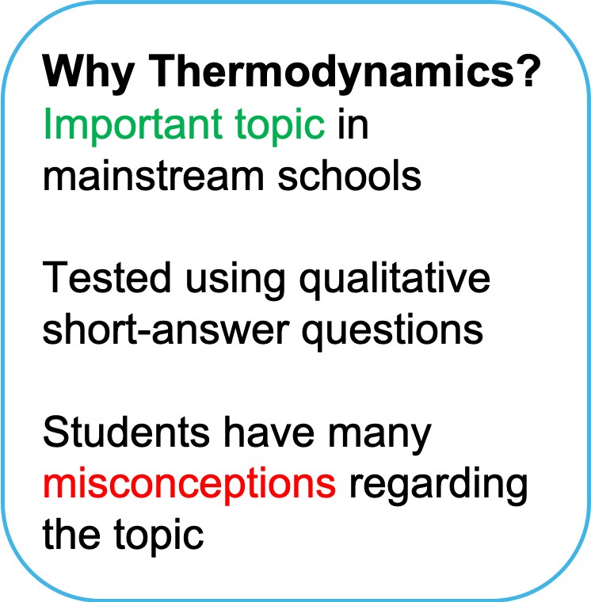
Datasets and Pre-processing
Notes:
You may be wondering, why thermodynamics?
Thermodynamics is an important topic in mainstream schools and can be easily tested using qualitative short-answer questions
In addition, students often have many misconceptions regarding the topic (CLICK)

Slide 19
Quantitative Component
Word Embeddings
Baseline Feedforward Neural Network
Long short-term memory (LSTM) and gated recurrent unit (GRU) Networks
Bidirectional RNNs (BiRNNs)
Attention Mechanism
Notes:
Moving on to our quantitative component, which, if you recall, aims to produce a score based on a student answer
We proposed a neural network model for as they have been shown to be extremely powerful in natural language processing
In order to design the best performing architecture, we propose different types of models below.
Firstly, we compare the use of different word embeddings like GloVe and FastText. Secondly, we fix our baseline model to be a simple feedforward neural network. Thirdly, we compare two types of Recurrent Neural Networks (RNNs), Long Short-Term Memory (LSTM) networks and Gated Recurrent Unit (GRU) networks. Fourthly, we compare the use of bidirectional RNNs (BiRNNs) and their unidirectional variants. Finally, we propose an attention mechanism. (CLICK)

Slide 20
Notes:
This is a diagram of the architecture of our final model. Simply put, each word in the answer is fed in one at a time into a neural network consisting of multiple layers, which analyses the answer and predicts the score the answer should get. Advay will now talk about the qualitative component

Slide 21


Qualitative Component
Marking Scheme
Strengths and Weaknesses
Notes:
The qualitative component essentially works by comparing student responses to the marking scheme, (CLICK), in order to draw out strengths and weaknesses in student answers. (CLICK)

Slide 22
j^{th} answer
n marking points
Marking point 1
Marking point 2
.
.
.
Marking point k
.
.
.
Marking Point n
0.5 = p_{j1}
0.0 = p_{j2}
Conduction is the transfer of thermal energy through a medium without…
0.4 = p_{j3}
1.0 = p_{jk}
1.0 = p_{j10}
0.5 = p_{jn}
Notes:
Basically, given a particular answer like the one on the left, we compare the answer to each of the marking points in the teachers’ marking scheme. For each marking point, a probability is assigned, denoting whether the answer captures a particular marking point. A value of 1 indicates that the answer has fully captured the particular marking point, while a value of 0 means that the answer did not capture the marking point at all.

Slide 23
Qualitative Component
Vector Decomposition
Cosine Similarity
Euclidean Distance
Notes:
In order to obtain the marking point proportions, we evaluated three different methods, namely vector decomposition, cosine similarity, and Euclidean distance, which are different ways of measuring how close an answer is to a particular marking point. In fact, cosine similarity is a simple application of what you will learn in vectors for H2 Math (CLICK)

Slide 24
Data and Discussion
Evaluation methodology, results
Notes:
Now I will be talking about how we evaluated our 2 components, before looking at our data

Slide 25
Evaluation Methodology
5-folds cross-validation (0.8 training, 0.2 validation)
Vary training set size from 25-250 samples with 42 in validation set
Simple feedforward NN to test accuracy of vectors generated by qualitative component
Notes:
For our quantitative components, we used 5-folds cross-validation, where 80% of the dataset was used for training and 20% was used for validation
In addition, we wanted to see how the performance of our best models varied with the size of our training set. So we varied the size of the training set from 25 to 250 samples at increments of 25, so like we used 25, 50, 75 and so on. 42 samples were in our validation set that was held constant
For our qualitative component, we hypothesised that if our model is able to generate accurate proportions of each marking point for a given answer, we should be able to accurately predict the score of the answer since the marking points are used by teachers to mark the answers. Hence, we fed the marking point proportions into a simple feedforward neural network to test their accuracy

Slide 26
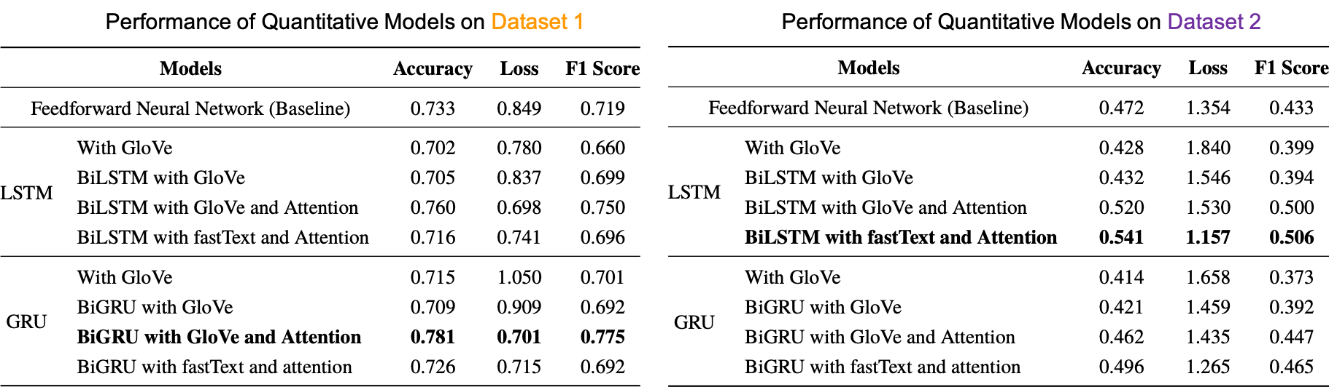
Quantitative Component
Notes:
These are the results from the 5-fold cross-validation of our quantitative component (CLICK)

Slide 27
Quantitative Component
Notes:
(CLICK AGAIN cos I needed to make the morph thing work)

Slide 28
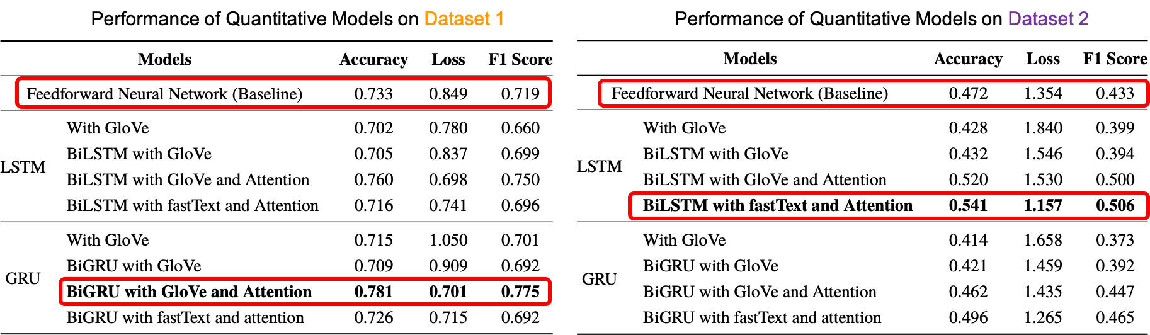
Quantitative Component

Slide 29
Quantitative Component
BiGRU with GloVe works best for simpler questions
BiLSTM with fastText for more complex questions
Models perform better on dataset 1
Notes:
We have boxed out the best models for each dataset in red. BiGRU with and attention worked best for the simpler questions while BiLSTM with fastText orked better for the more complex question. We hypothesise that this is because the more complex question requires a greater computational power and so LSTM, which is strictly stronger than GRU, performed better.
In addition, the models performed better on dataset 1, probably because dataset 1 is easier due to the easier question (CLICK)

Slide 30
Quantitative Component
Simple baseline models do surprisingly well
May have overfitting and poor hyperparameter tuning in the more complex models
Notes:
Now, one thing to note is that our baseline models do surprisingly well, beating some of the more complex models. We hypothesise that this is because the more complex models are prone to overfitting on the dataset and we did not properly tune their hyperparameters (CLICK)

Slide 31
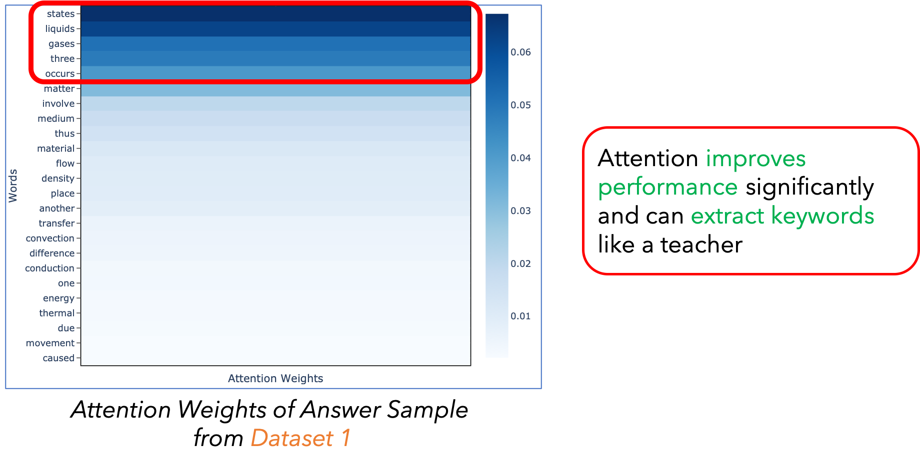
Quantitative Component
Notes:
This here is a diagram of the attention weights we extracted out from one of our more complex models after we ran a sample student answer through it (CLICK)

Slide 32
Quantitative Component
Notes:
Zooming in, we see that the attention mechanism is able to extract some keywords from the answer, just like a teacher. Also, from our previous results, the attention mechanism can improve the performance of our models up to 8% which is really significant, showing that it is effective

Slide 33
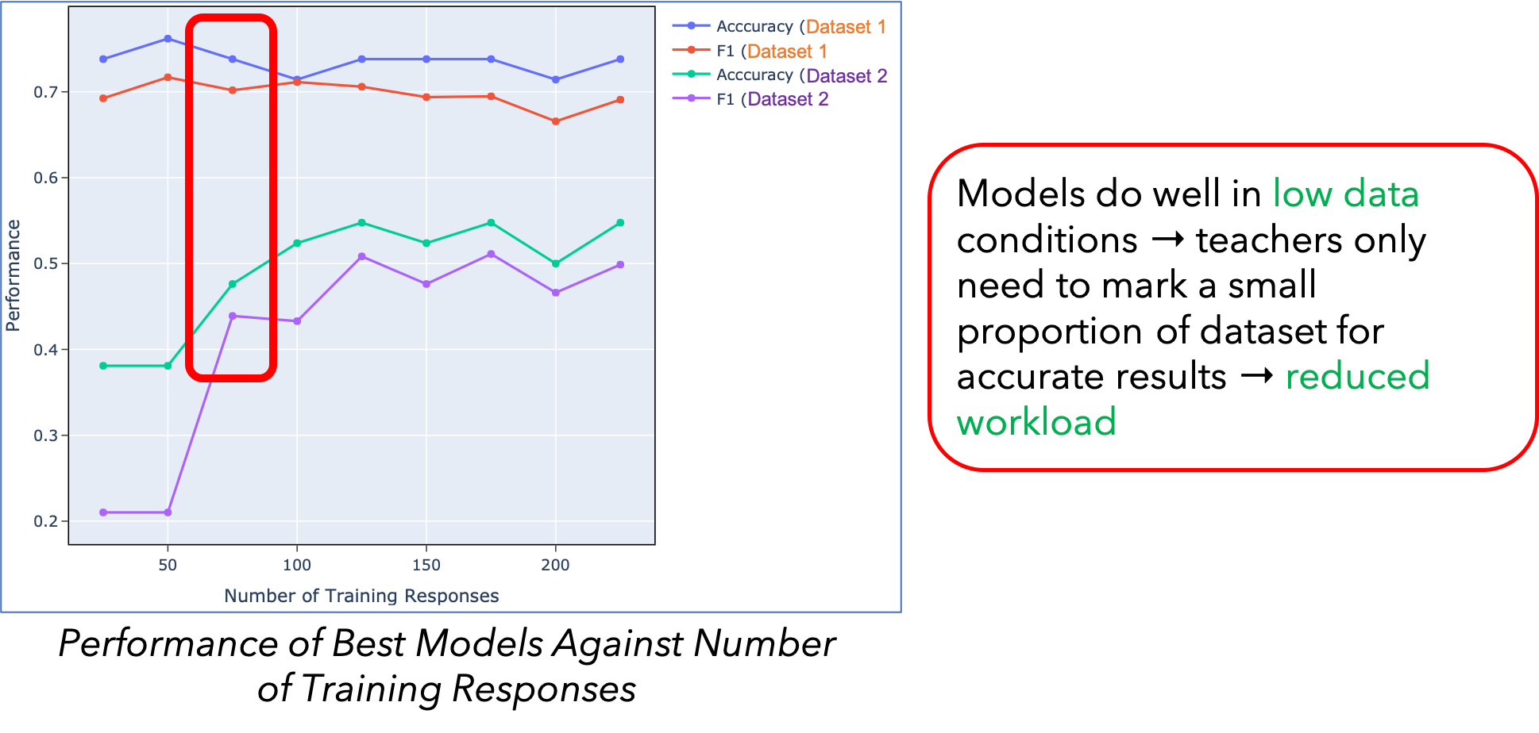
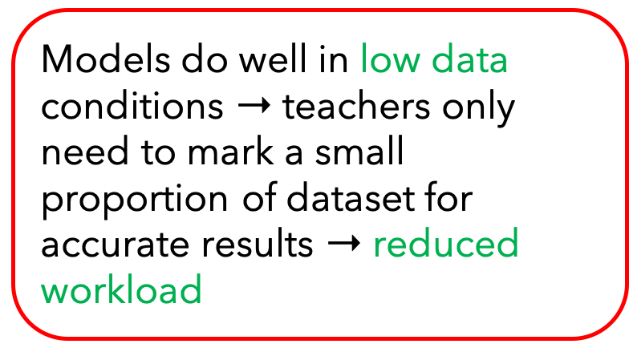
Quantitative Component
Notes:
These are the results from the varying the size of the training set. We can see that the models do well in low data conditions. (CLICK)

Slide 34
Quantitative Component
Notes:
From about 75 training examples and above, the models do consistently well. This means that teachers only need to mark a small proportion of the dataset for accurate results, allowing our models to reduce their workload

Slide 35
Qualitative Component
Notes:
Here’s the results from running the marking point proportions from our qualitative models through the simple feedforward neural network (CLICK)

Slide 36
Qualitative Component
Notes:
(CLICK)

Slide 37
Qualitative Component
Cosine similarity performs best
Good indication of accurate marking point proportions
Performance similar to complex quantitative models → possible overfitting, poor hyperparameter tuning
Notes:
So we see that cosine similarity performs the best out of all the qualitative models
This means that our marking point proportions are likely to be accurate
Also, we note that the performance of our qualitative component is actually quite similar to that of the complex quantitative models, possibly for the same reasons of overfitting and poor hyperparameter tuning

Slide 38
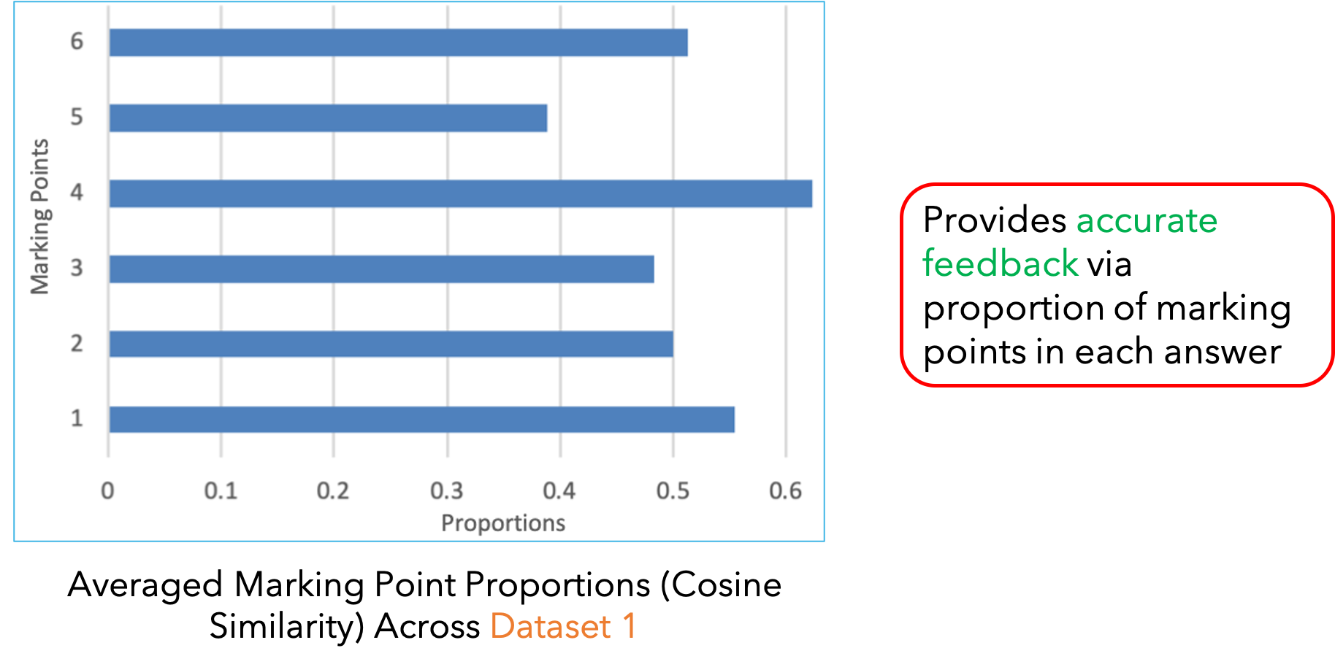
Qualitative Component
Notes:
So you may be wondering what the marking point proportions can do. Over here, we have visualised the marking point proportions that are averaged across dataset 1. Such visualisations can be also done for the individual students. From here, we can see that some marking points like 4 are included more in student answers while others like 5 are less included. This allows teachers and teachers to easily identify areas of improvements and also possible misconceptions, providing accurate feedback

Slide 39
Improvements
Create a cross-validation set in addition to a training set and a test set. This is because we are currently optimising the hyperparameters on the test → results are biased estimates of how our models will do on unseen data.
Using early stopping and model checkpoints to save the model that performed best on the validation set is not the best practice as it similarly relies on the test set to pick the best model. Instead, other methods of addressing over-fitting can be employed, including an increase in regularisation and creating more training data.
Current state-of-the-art models are mostly transformers instead of LSTMs. It would be interesting to train a transformer (or fine-tune an existing one) on this dataset to compare the performance.

Slide 40
Thank you!
Notes:
That brings us to the end of our presentation. Thank you!

